Slide 1

Creating a tool for Data Science job applicants to negotiate salaries
Data Science Bootcamp
Rich Kirschenheiter, Arielle Eagan, and Timothy Kelley

Slide 2
As future Data Science and STEM professionals, graduates of the NU Data Science Bootcamp are curious about the job market and earning potential in new roles available after the Bootcamp….

Slide 3
Based on our experience level, what positions should we apply for?

Slide 4
And for those roles, what salaries can we ask for?

Slide 5
As an applicant, salary negotiations are daunting. No one wants to go into negotiations without a sense of what others are being paid and what they can ask for.

Slide 6

So…. we created a tool.

Slide 7

First, we found a data source.

Slide 8
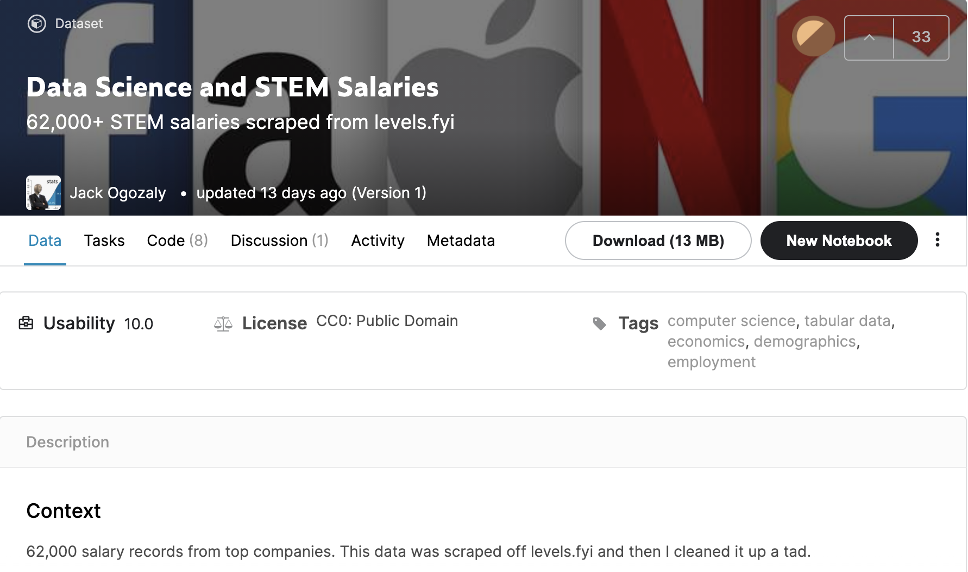
Our original data source:
Through Kaggle, we found a dataset of US-based Data Science and STEM Salaries available through Kaggle, which provides 62,000 salary records from top companies throughout the country.
Format: csv
Link: https://www.kaggle.com/jackogozaly/data-science-and-stem-salaries
Data set included:
company name
job title, location (city and state)
compensation (total yearly compensation as well as base salary, bonus, stock grants)
demographics (education level, gender, and race)

Slide 9
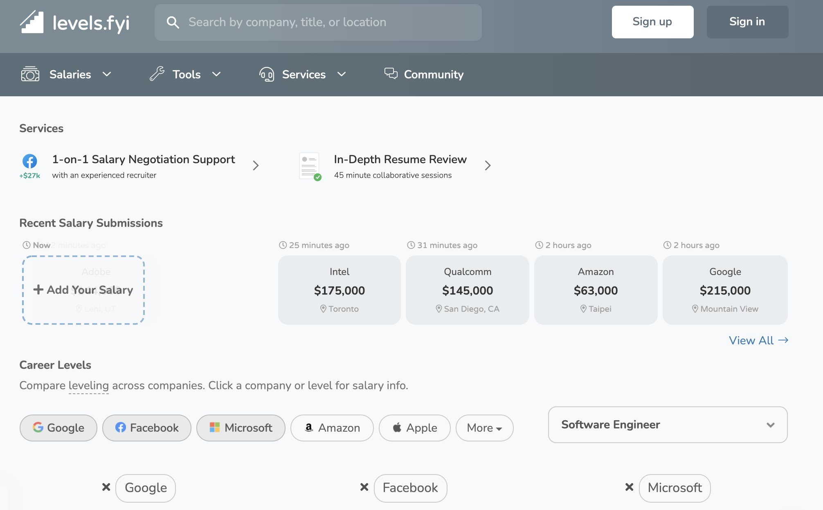
Adapting our source so our data could be as up-to-date as possible:
Looking at the dataset’s source, we found that the data was scraped from a site called levels.fyi .
Link: https://www.levels.fyi/?compare=Google,Facebook,Microsoft&track=Software%20Engineer
Using this source, we found an API in JSON format that allowed us to pull more updated data, running only about 6 days behind current present day.
Though this did mean that we no longer had access to some demographic data (education level and race), we choose to use this API to ensure that our project and its visuals would have the most up-to-date data.

Slide 10
Then, we explored and cleaned our data.

Slide 11
Due to the depth and detail of our data, we decided to use a Thick Server.

Slide 12

This means that we would deeply explore and clean the data on the back end.

Slide 13
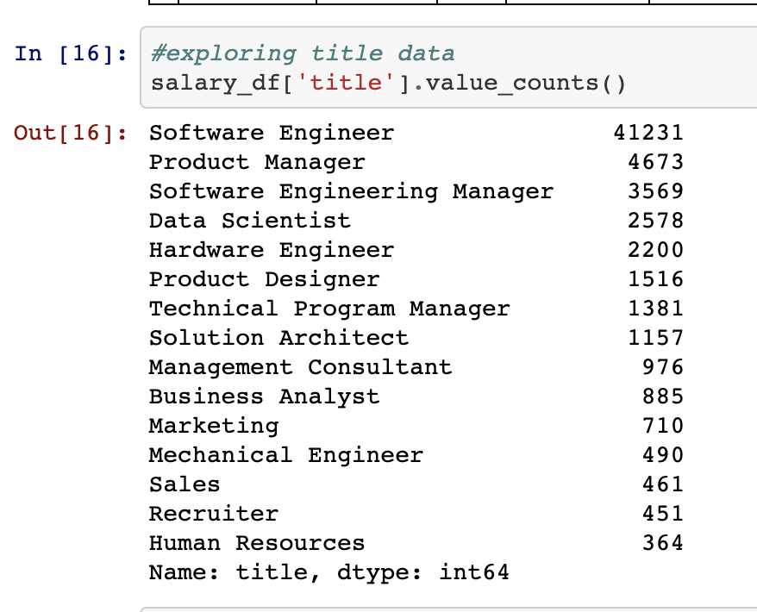
We used jupyter notebook to explore and clean our data.
Steps we took to clean the data:
Analyzed data first
Dropped non-relevant columns (ex: kept city name but dropped ”cityID”
Began to analyze salary data
Began to analyze different companies
Began to interpret “levels” of roles at each company
Created bins for “entry”, “mid”, and “senior” levels

Slide 14
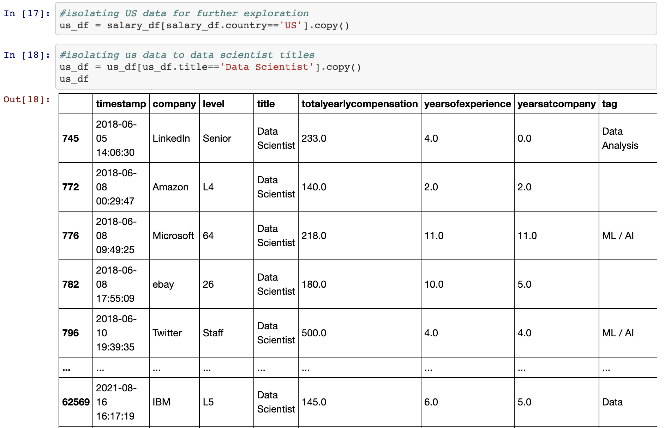
We explored and isolated US-based Data Science positions.

Slide 15
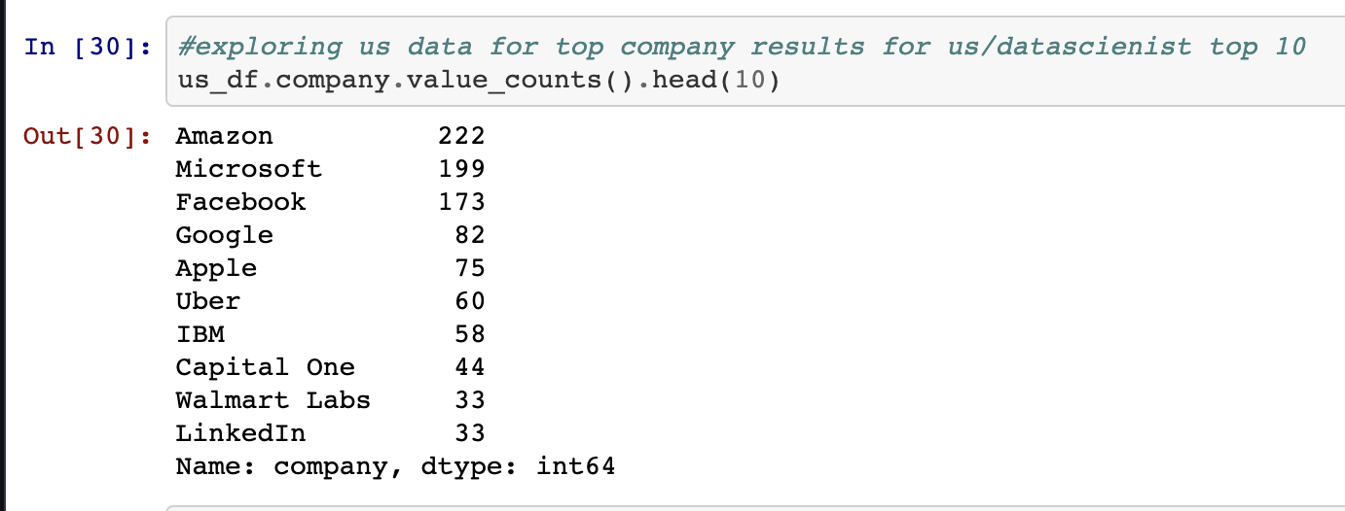
We explored and isolated the top companies with Data Science positions.

Slide 16
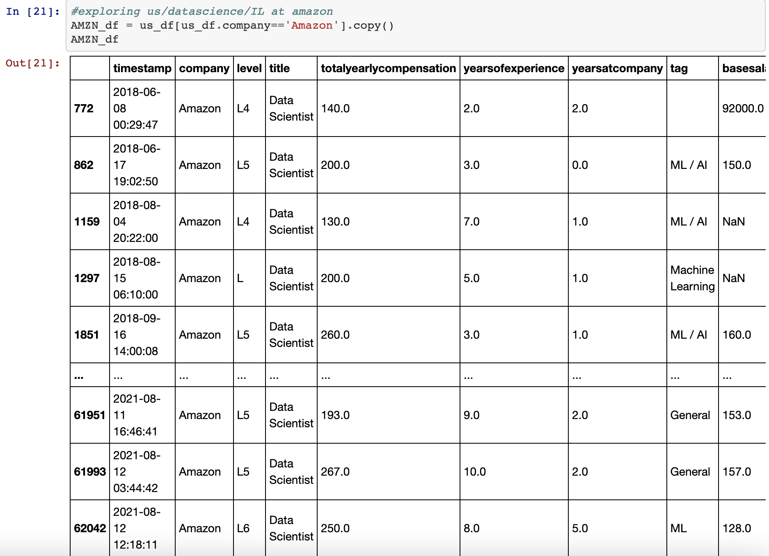
We did a deep dive into the Data Science positions at each company.

Slide 17
We realized that there are multiple levels to Data Science positions.

Slide 18
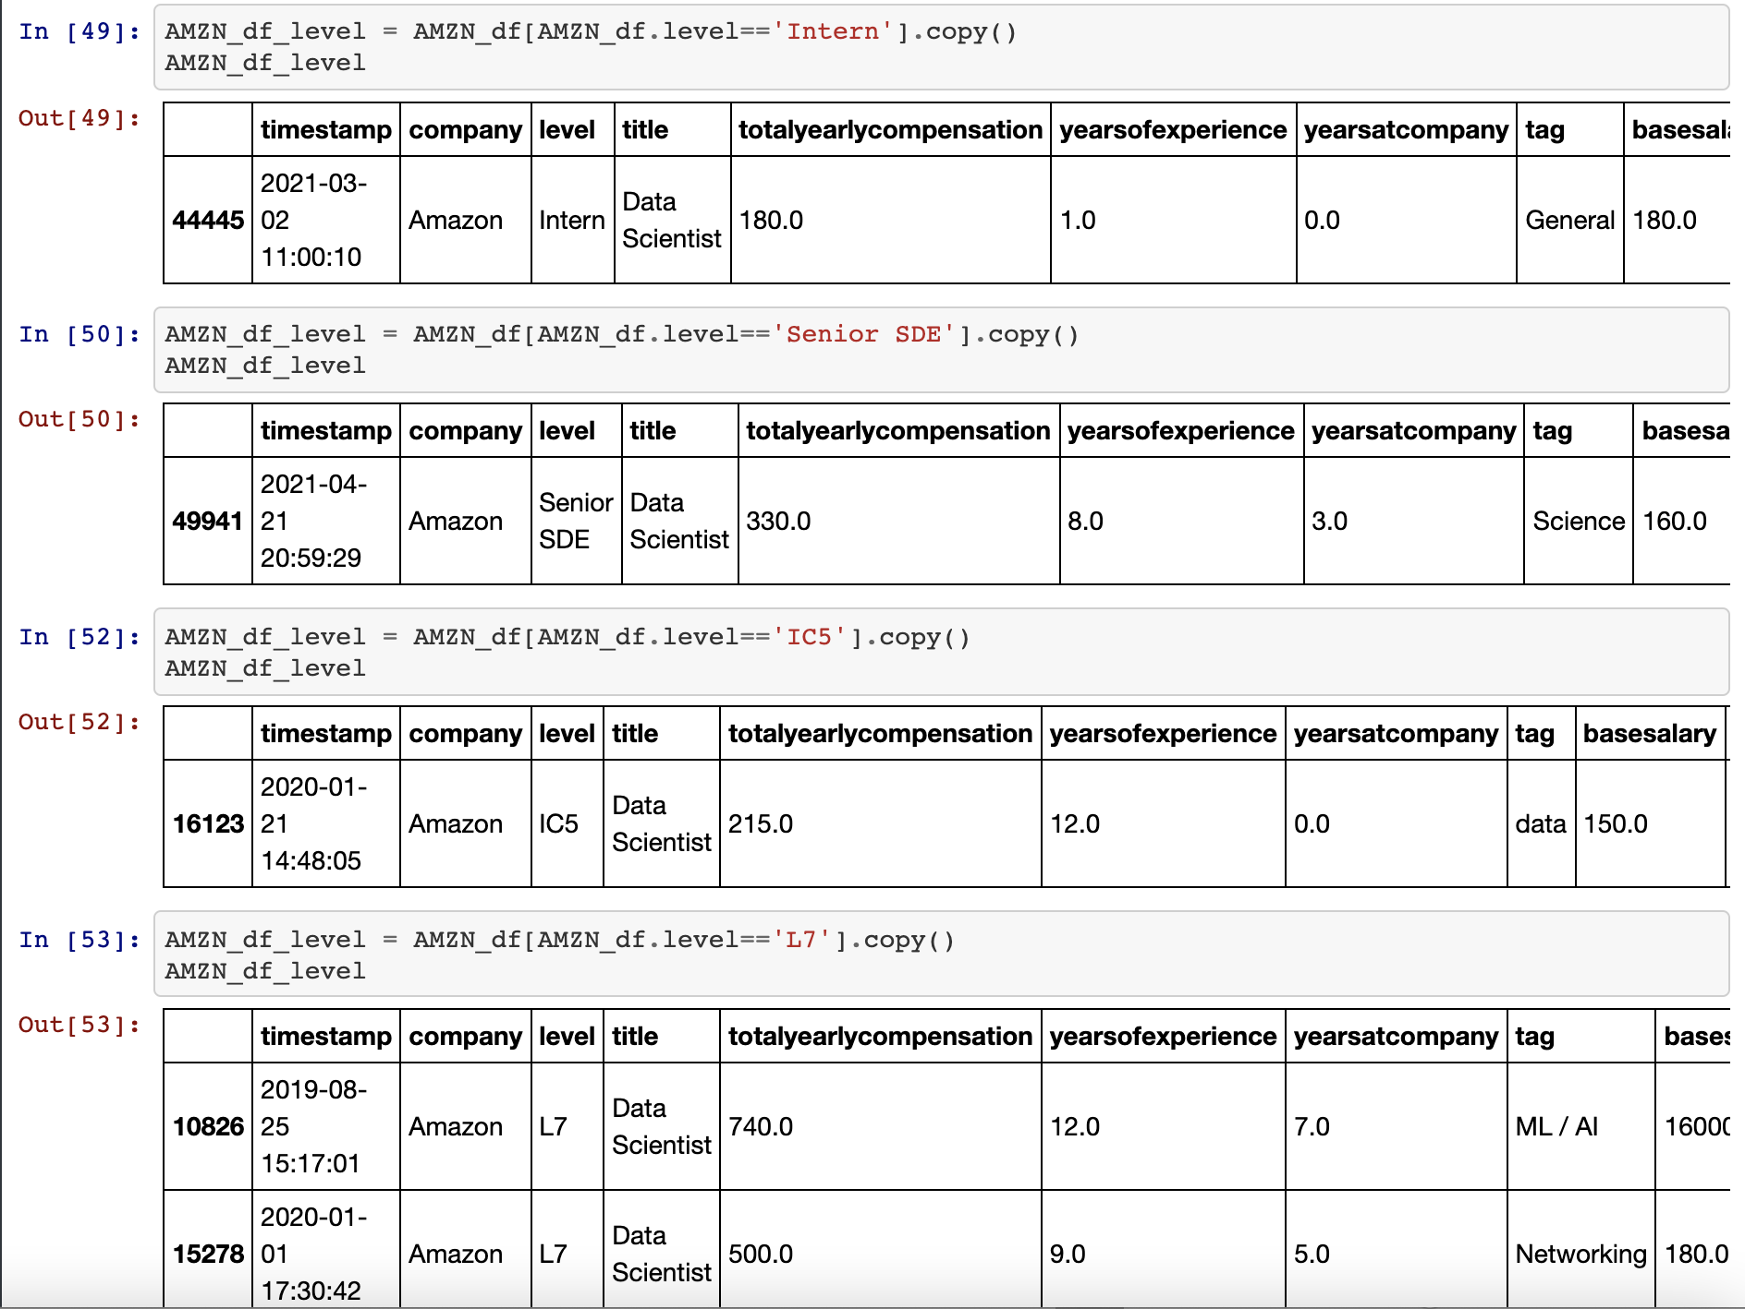
So we explored position levels within Data Science positions.

Slide 19
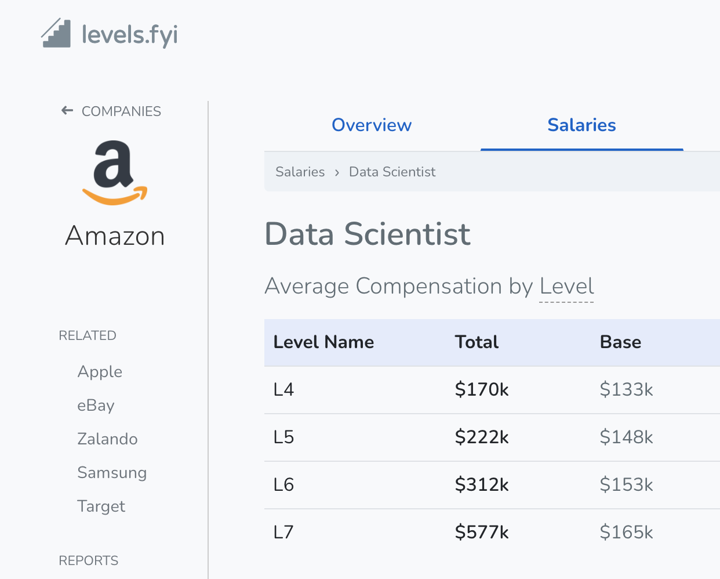
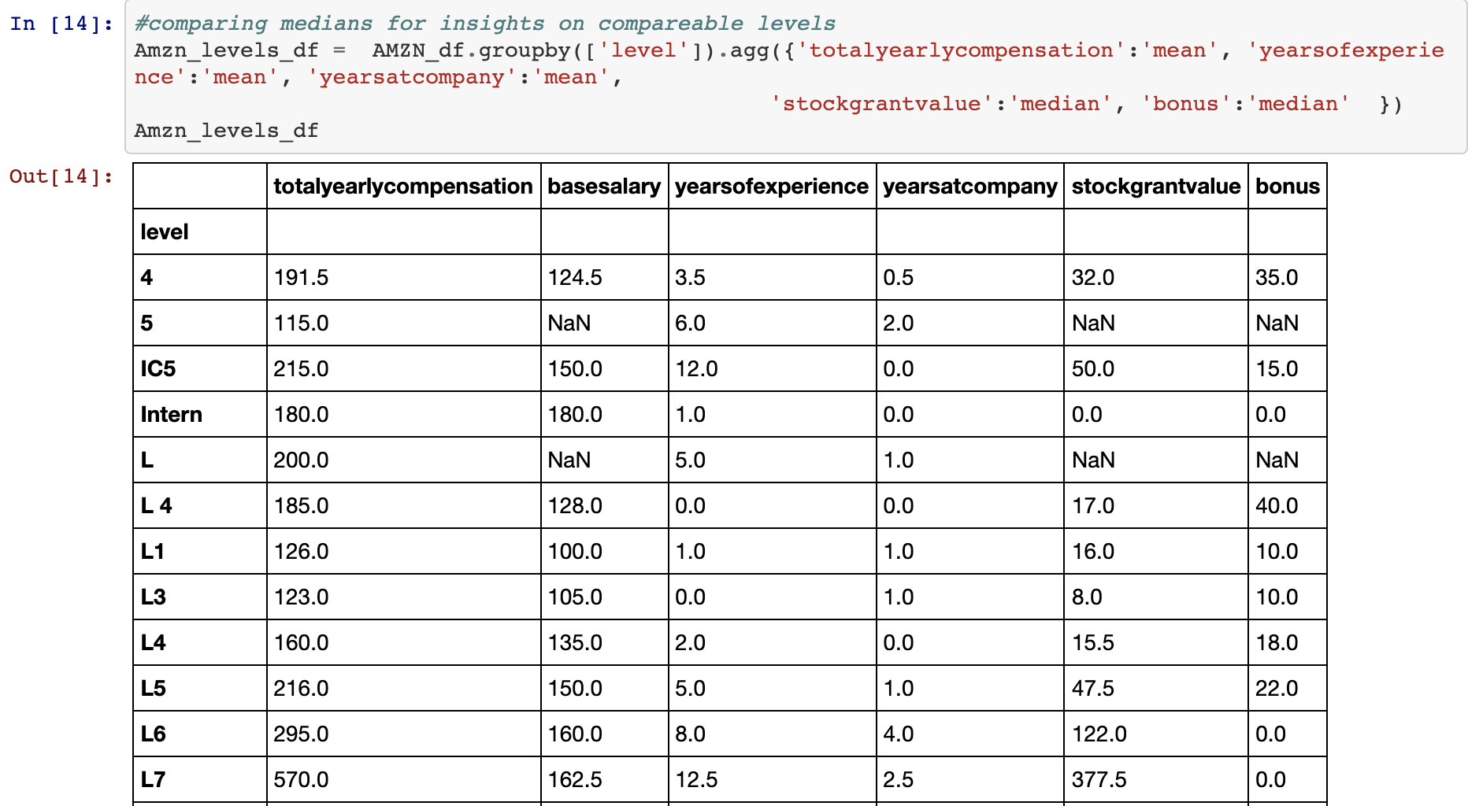
We used market research and statistics to identify Data Science position levels.

Slide 20
We removed positions that did not fall into the company’s levels, likely due to data entry errors.

Slide 21
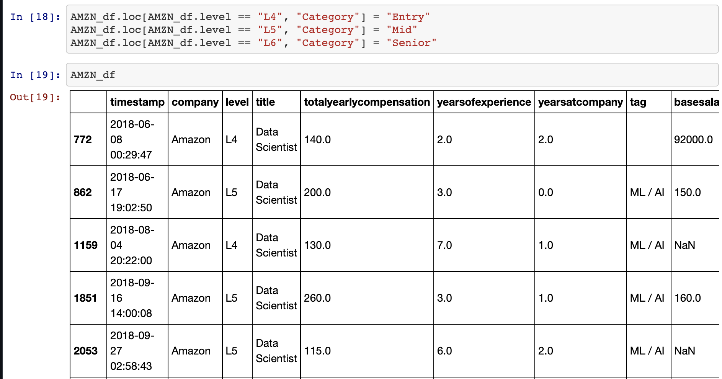
Using market research and statistics, we binned positions into three levels: Entry, Mid, and Senior Data Scientist.

Slide 22
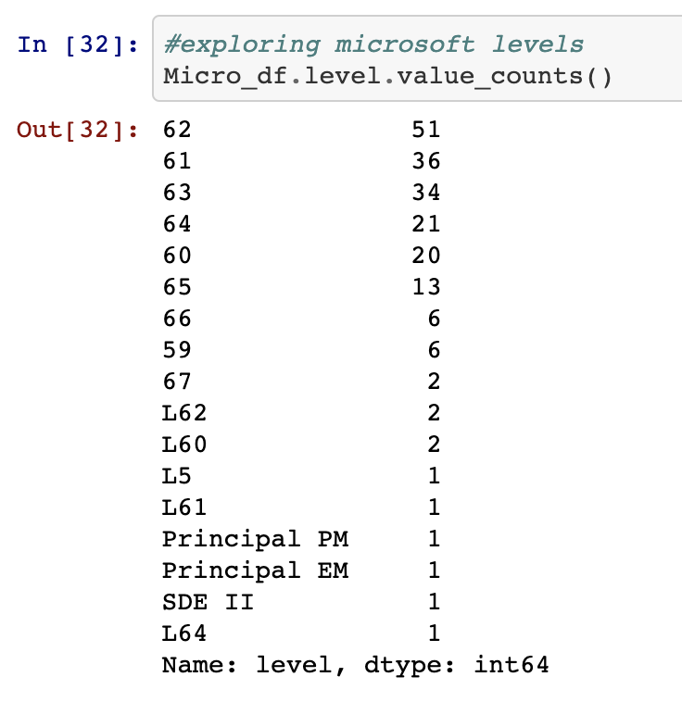
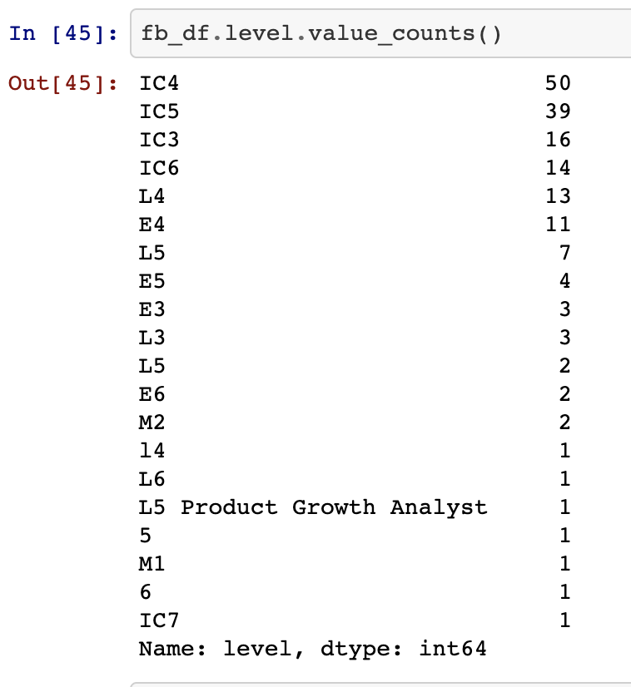
Using market research and statistics, we binned Data Science position levels at the top 5 companies.

Slide 23
Then we created one clean Python script.

Slide 24
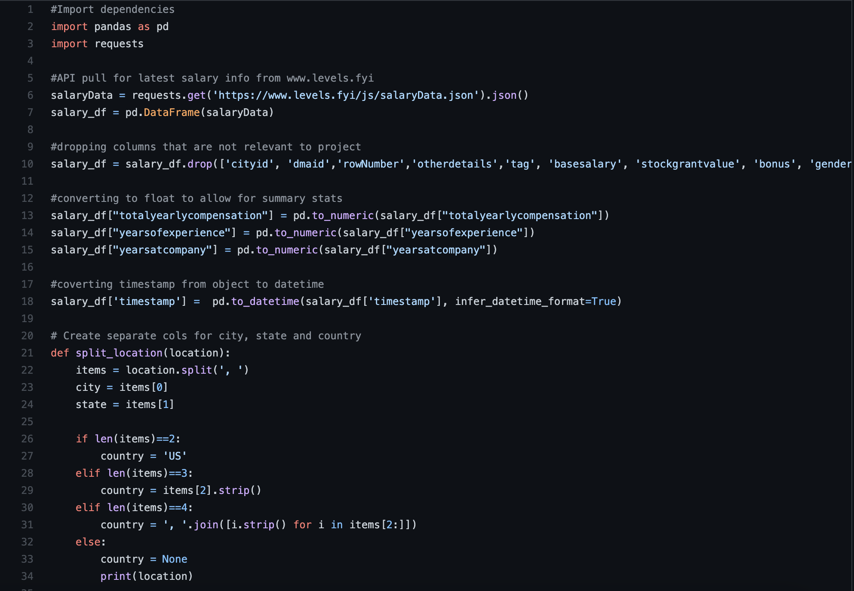

Slide 25
Then, using the Chart.js library, we created our interactive online tool.

Slide 26
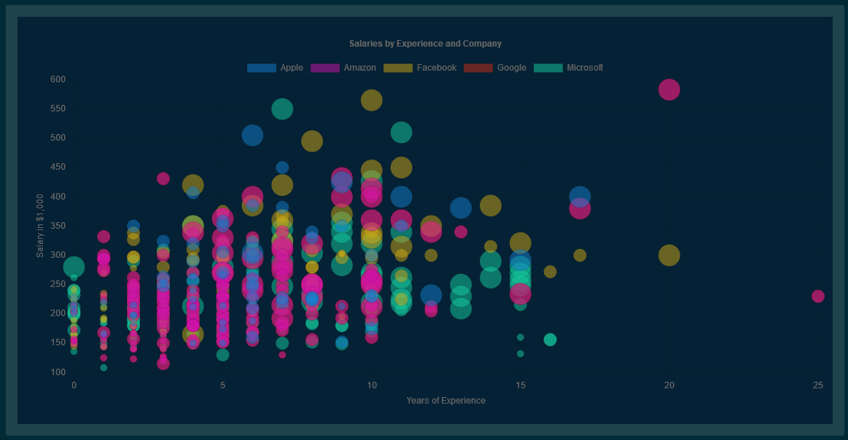
Notes:
(demo now)

Slide 27
To our knowledge, this is the first open-source interactive tool that helps Data Science applicants educate themselves on top companies’ positions and salary potential.

Slide 28
And with your support….

Slide 29
we can do even more.

Slide 30
With your partnership, we can make the tool even better:
Expand position details:
Add tags for Machine Learning (ML) and Artificial Intelligence (AI)
Expand important demographics:
Research shows that certain applicant groups are at higher risk of being offered lower salaries. Educated negotiation is key.
Consider impact of location in USA (state-level, urban vs. rural)
Add additional companies:
Further explore original data source's mislabeled positions
Expand salary details:
Currently shows "Yearly total compensation"
Could further expand to show:
Further explore:
Consider impact of race
Consider potential impact of gender
Top 5 data science companies picked based on volume in original data source.
We could expand to top 10 companies.
We could add companies of interest based on:
geography
increasing popularity (ex: new, fast-growing companies)
base salary
stocks
bonus
Could further show years at company
internship positions
executive positions

